Slide 1
Patient Drug Switch Prediction
Tirthankar Das

Slide 2
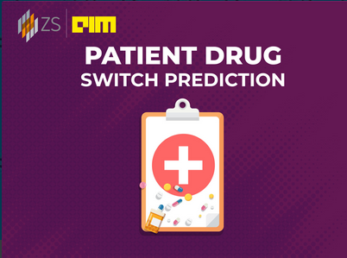
Steps of Prediction Model
Data Block
Code Block
Data Block
Train Data
Test Data
Step1
Train Feature
Generation
Feature Extraction
Code
Test Feature
Generation
Total Features: ~4k
Step 2
Feature Selection
Code (used LGB)
List of Important
Features
Train Data for
Model Input
Test Data for
Prediction
Step 3
Final Features for Model:
6998
Model Building
Code (used LGB)
Predicted Output

